Slide 1


Accelerating Pakistan's Clean Energy Transformation
Exploring 12 Years of Pakistan's Power Generation Data. Focus on Renewable Energy Growth, Solar Energy, and for Tracking Sustainable Development Goal (SDGs).

Slide 2



Project Members
Talha Bin Omar
BSDS 23
Sami Ullah Abbasi
BSDS 23
Ayema Amir
BSDS 23

Slide 3

Project Overview
This project leverages historical power generation data (2012-2024) to analyze energy trends, with a focus on SDG Goal 7: Clean and Affordable Energy. A detailed comparison of renewable vs. non-renewable sources highlights Pakistan's gradual transition towards sustainable energy solutions.
This Photo by Unknown Author is licensed under CC BY

Slide 4

Methodology: Data Collection & Analysis
Data was downloaded from State Bank of Pakistan’s Data Portal. The data was cleaned and pre-processed for analysis in Power BI. Key focus on trends, market shares, and growth patterns over the years.

Slide 5
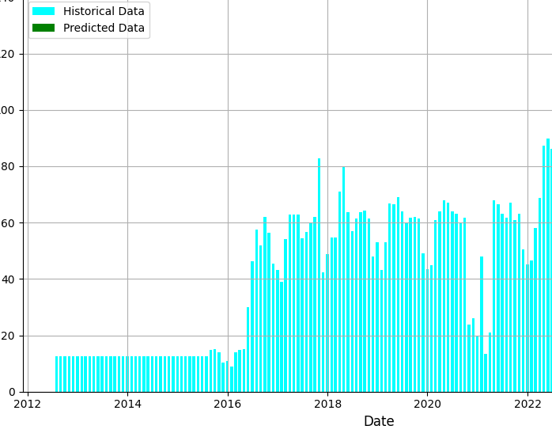
Methodology: SARIMA Model for Solar Predictions
The SARIMA model was trained on historical data to forecast solar power generation. This predictive model identifies seasonal patterns in historical data and forecasts solar energy growth over the next 15 years.

Slide 6
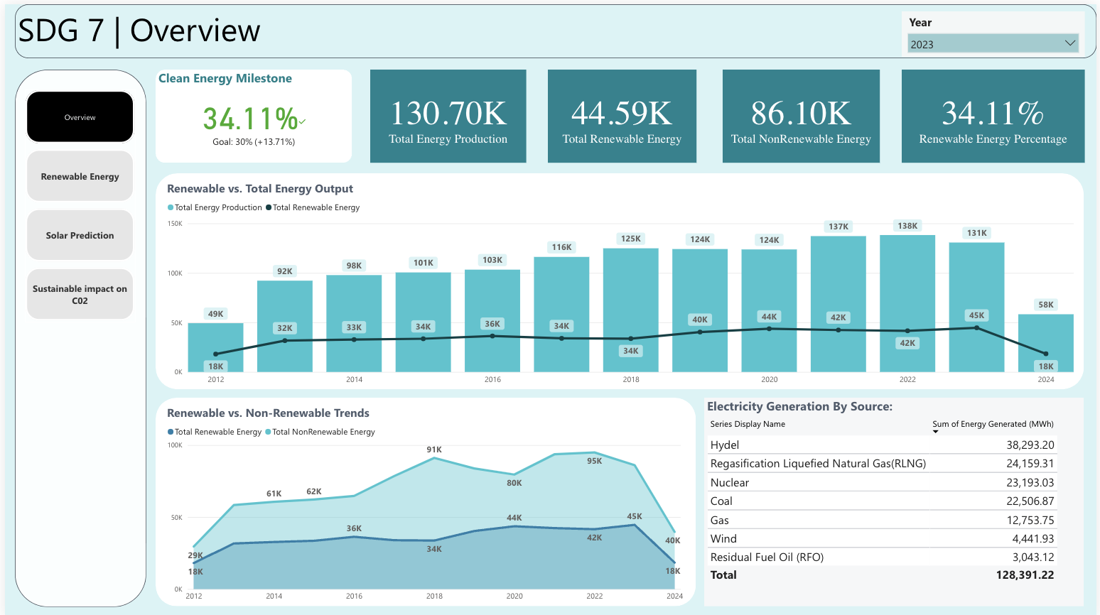

Dashboard 1: Overview Renewable vs. Non-Renewable Energy
The first dashboard provides a year-wise comparison of renewable vs. non-renewable energy. It visualizes market share, energy generation by source, and shows trends of increasing renewable energy adoption.

Slide 7
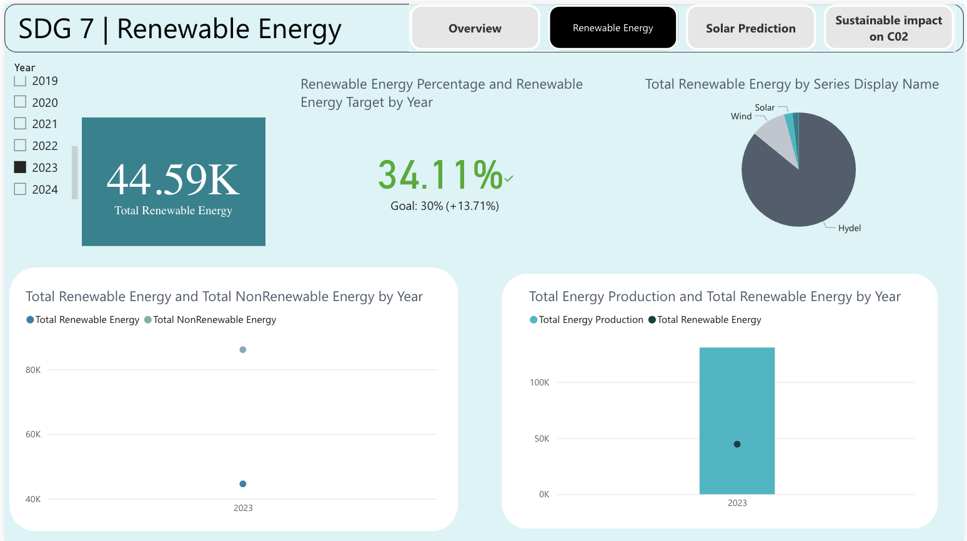
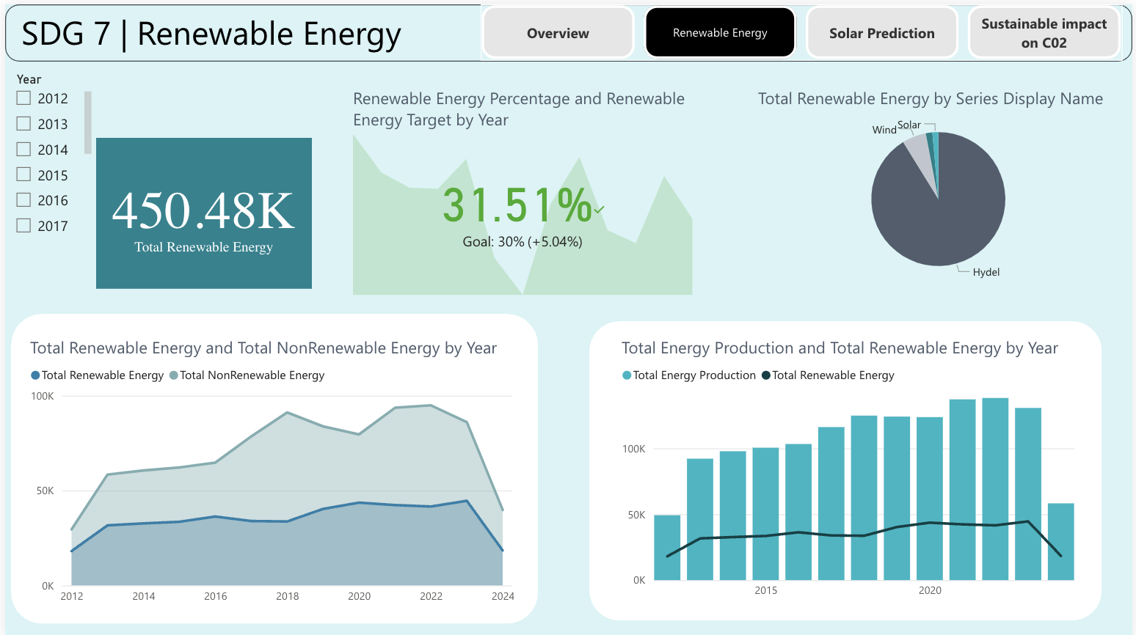
Dashboard 2: Renewable Energy Focus
Focus on renewable energy sources, breaking down solar, wind, hydro, and other clean energy types. This dashboard emphasizes their contributions to the overall energy mix.

Slide 8
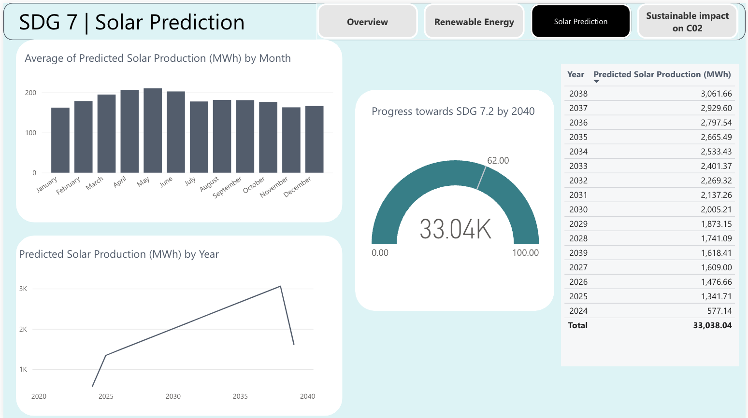
Dashboard 3: Solar Power Predictions
Using a SARIMA predictive model, this dashboard shows the forecast of solar energy growth. It predicts solar power generation for the next 12 months and aligns with Pakistan’s clean energy goals.

Slide 9
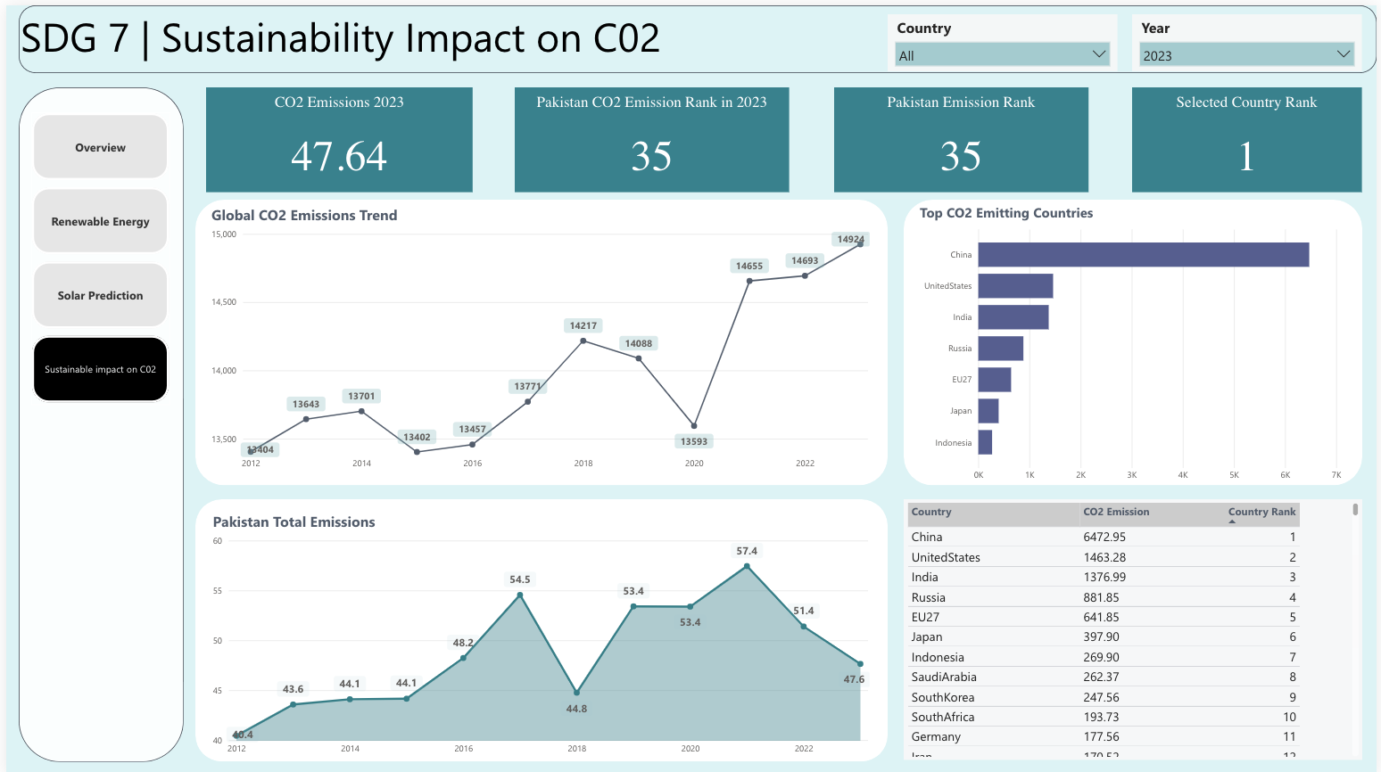
Dashboard 4: CO2 Insights
CO2 emissions are plotted against renewable energy growth. The dashboard highlights how the shift to clean energy has contributed to a reduction in carbon emissions over time.

Slide 10

Findings: Growth of Renewable Energy
Renewable energy has grown steadily, rising from 18,038 MWh in 2015 to 44,586 MWh by 2023, with solar power leading the way. In the first half of 2024, renewables generated 18,631 MWh. Over the past two years, We saw a notable decrease in CO2 emissions, reflecting the positive impact of its clean energy transition on economic growth and energy security.

Slide 11
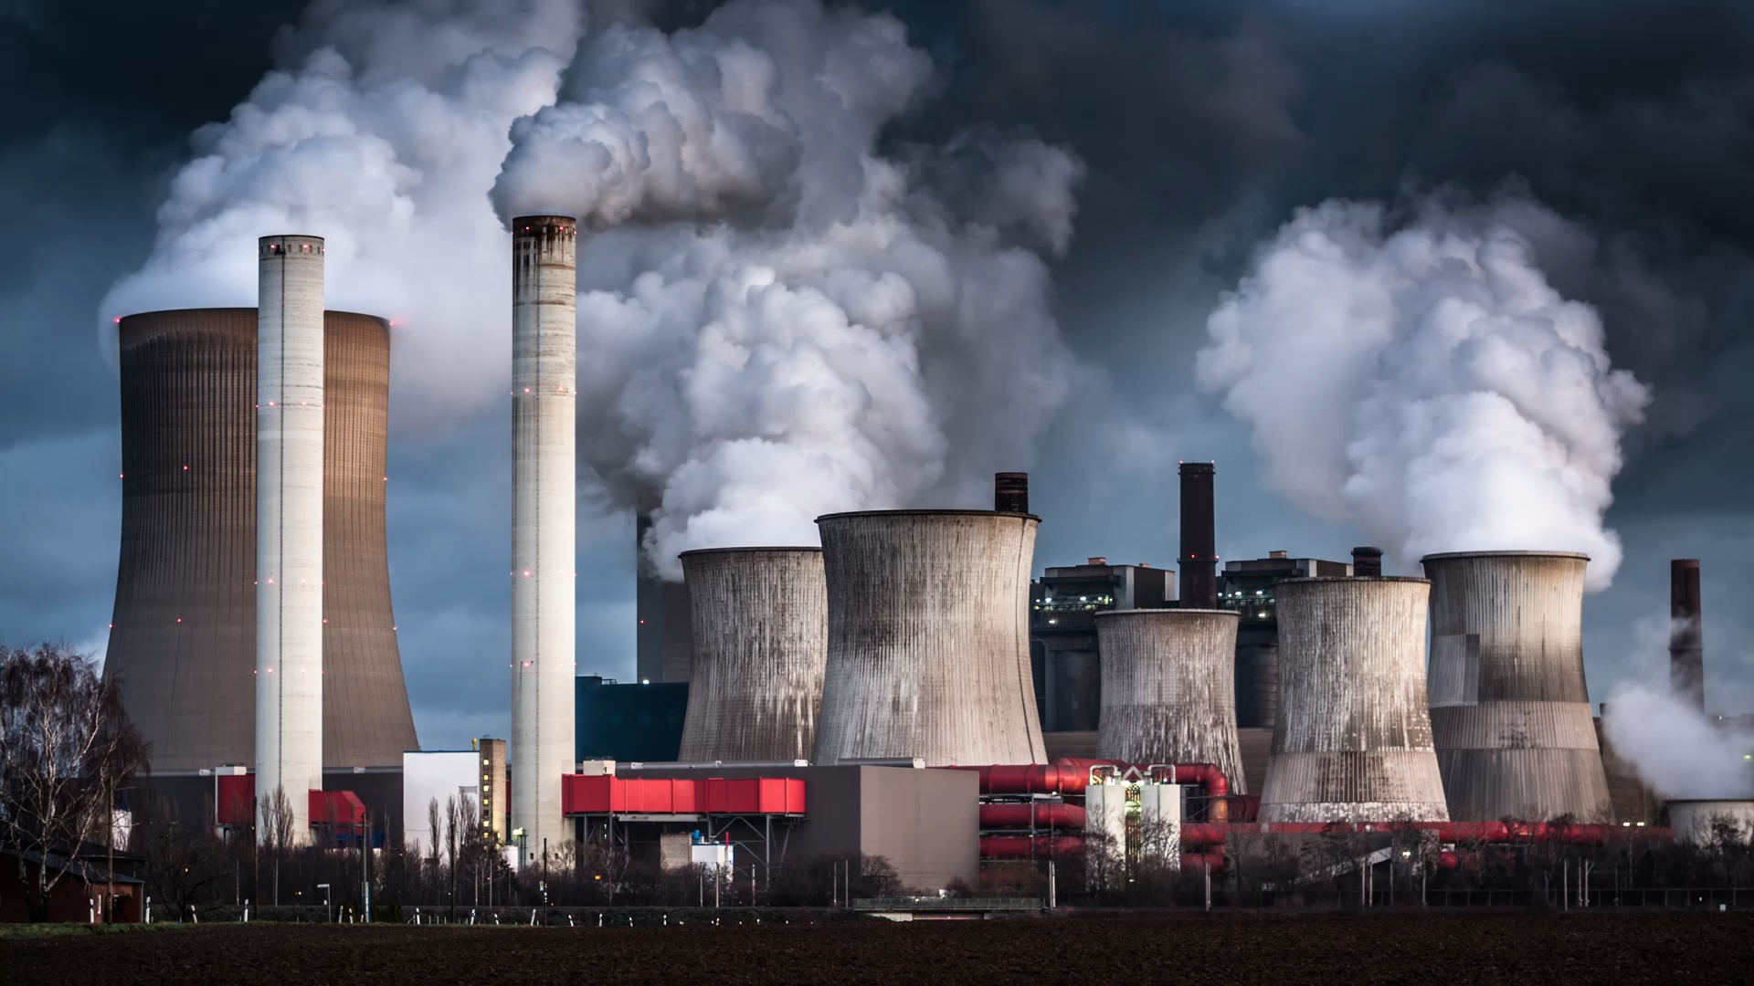
Findings: CO2 Reductions & Climate Impact
A reduction of 12.67% in CO2 emissions was observed from 2017 till 2023 as renewable energy increased. This supports Pakistan's commitment to the Paris Agreement and global climate action efforts.

Slide 12

Challenges and Limitations
Data Quality & Integration: Incomplete data required cleaning, and combining various renewable sources was complex.
Infrastructure Limitations: Pakistan’s renewable energy growth is hindered by grid capacity and storage issues.
SARIMA Model: Effective for short-term forecasts but less reliable for long-term predictions due to dependence on historical patterns.

Slide 13

Conclusion: Towards a Greener Pakistan
The transition to renewable energy is critical for Pakistan's sustainable future. By prioritizing clean energy, we can enhance our energy security and play a vital role in combating climate change. This commitment is essential for building a resilient and sustainable energy landscape for generations to come.

Slide 14

Future Implications & Recommendations
Recommendations include further investment in renewable energy infrastructure and Electric Vehicles Charging infrastructure, scaling solar power projects, and continuous monitoring of CO2 emissions and energy consumption patterns.

Slide 15
Thank You for Your Attention!
We look forward to your support in our journey towards a sustainable energy future for Pakistan.

